Slide 1

Bull Market or Bear Market: Time Series Price Prediction for Q1 2024:
Team 1:
John Vincent Deniega
Ravita Kartawinata
Gabriella Rivera
Master of Science in Applied Data Science, University of San Diego
Notes:
Hello.
We are team 1. John, Gabriella and myself, Ravita.
We want to invite you to explore stock price market prediction in the first quarter of 2024. Would it be bull or bear market?

Slide 2
Problem statement and goal
Current Issue
A prolonged downturn in financial market
Market experiencing significant volatility in Q4 2023
Difficult to predict financial market and their subsequent investment vehicles such as SPY, AMZN
Goal
To be able to inform investors to make better investments, and we aim to use time series analysis to find ways to find those "better ways“
Find a model or method that can predict prices accurately in the future
Find a model or method that can predict what influences the stock market price direction
Success criteria : +/- 20% prediction error
Notes:
Situation:
The stock market is experiencing fluctuations with unpredictable movements, creating a state of uncertainty.
In the fourth quarter of 2023, the US stock market is experiencing significant a prolong downturn and instability. Financial markets and their subsequent investment vehicles present significant opportunity to manage risk and build capital.
Through deeper understanding of the underlying characteristics of the markets and these vehicles, we may be able to leverage our growing knowledge in price movements of its level, trend, seasonality, and others factors which may influence the price movement throughout periods of time.
Goal:
The goal is to predict with sound data science principles where the US stock market will be by the end of the first quarter of 2024 and further to strengthen our ability to perform time series price prediction to manage risk and build capital. Using data and model, we aim to find an edge of providing investors to make a better investment decision.
Approach:
Basically, we will explore a two-pronged approach to accomplish the business objective
Find a model or method that can predict prices accurately in the future
Find a model or method that can predict what influences the stock market to go up

Slide 3
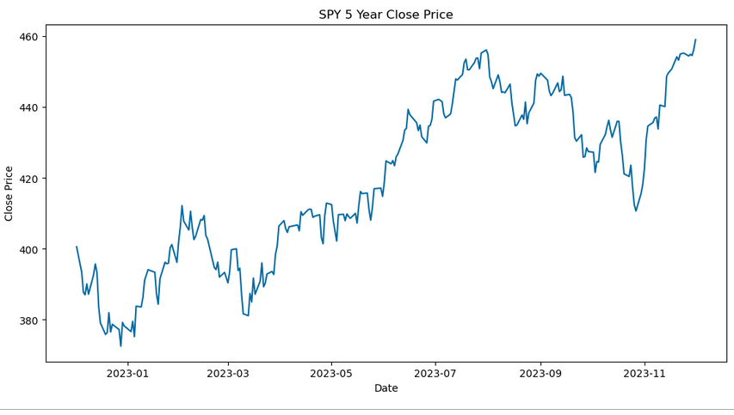
Data source and information
Data Source
Finance Yahoo Library (yfinance)
Data Information:
SPY : SPDR S&P 500 ETF which is traded in NYSE
AMZN : Amazon Stock which is traded in NASDAQ
Time Period : 5 years
Notes:
Dataset is live financial market data sourced from Yahoo Finance with an extensive set of modules, attributes, and methods available to be utilized. We focus on 2 tickers which are SPY (S&P 500 ETF) and AMZN with 5 years periods.
As we can see SPY price movement in 2023 shows trend and seasonality.
Gabriella will lead us to explore the data further.

